Slide 1

Tourist management system (TMS) School of Environmental Science and Management Faculty of Science and Technology Pokhara University, Nepal July,2024
Prepared by :
Shuprabha Mainali Shishir Devkota Raghav Panthi

Slide 2
Content
Title | Page
1:Introduction | 3
2:Challenges in Tourism | 4
3: Objectives of the TMS | 5
4:Literature Review | 6
5:Methodology | 7
6:Flow chart | 13
7:Data Flow Diagram | 14
8:Outcomes | 16
9:Future Work | 21

Slide 3
1.Introduction
A Tourist Management System (TMS) is a platform designed to manage and streamline all aspects of tourism activities. It serves as a central hub for tourists, enabling them to easily access information, booking tickets .By integrating technology into traditional tourism practices, a TMS enhances the efficiency and effectiveness of managing tourist data and services.

Slide 4
Challenges in Tourism
Physical documents are vulnerable to damage and loss of tourist .
Manual booking processes are time-consuming and error-prone.
Long queues and delays frustrate tourists.

Slide 5
3: Objectives of the TMS
General Objective: Manage ticket and data bookings for tourists.
Main Functionalities:
Book Ticket (Creating)
View Ticket (Reading)
Sign-off (Deleting Tourist Data)

Slide 6
4:Literature Review
We studied the Tourism Management System found on the internet (2022,GeeksforGeeks) and discovered the following functionalities:
Features:
Package selection,
passenger details collection,
receipt generation
Then we enhance Tourist Management System with adding the following Improvements:
Dynamic file handling
Selecting current date when tourist enter.
Random ticket generation
Record deletion and viewing
User-friendly interface

Slide 7
5: Methodology
Requirement Analysis
Planning
System Design
Testing
System Development

Slide 8
Planning phase:
We conducted meetings and interviews with stakeholders, including tour operators, travel agents, and tourists, to understand their needs and main points.
Detailed plan with development approach, timeline, budget, task assignments.
Project goal and objectives decided.
Requirement Analysis conducted.

Slide 9
Requirement Analysis Phase
Collected user requirements from stakeholders.(सरोकारवालाहरु।)
Identified key functionalities:
Adding, deleting, viewing tourist records.
Secure file handling.
Robust error handling.

Slide 10
System Design Phase
Focus on
System Architecture:
Information Management.
Record Operations.
File Handling.

Slide 11
System Development Phase
Developed using C programming language.
Key tasks:
Defining Data Structures.
Generating Ticket Numbers.
File Operations.(csv Excel file)
Error Handling.

Slide 12
Testing Phase
Comprehensive testing conducted by :
Unit Testing.
Integration Testing.
User Acceptance Testing (UAT).

Slide 13
6:Flow chart
Start
Enter choice: 1 to add tourist, 2 to delete data , 3 to add new destination ,4 to display specific tourist data,5 to display all data, 6 to exit
If choice== 1
Yes
Add tourist.
No
If choice== 2
Yes
Delete tourist data.
No
If choice== 3
Yes
Add new destination
No
If choice== 4
Find the key of tourist
Display data of that Tourist
found
No
Not found
If choice== 5
Yes
Display all data of tourists
No
If choice== 6
No
Invalid choice
Yes
End
FIGURE : Flow chart

Slide 14
7:Data Flow Diagram
Request
Tourist management system
Database
Admin
Response
FIGURE :Level 0 DFD

Slide 15
Level 1 DFD
Tourist
Request
Add tourist
Generate ticket number and select current date
Admin
Response
Request
View tourist
Response
Database
Request
Delete tourist
Response
Request
Add new destination
Response
Request
FIGURE :Level 1 DFD
Exit
Response

Slide 16
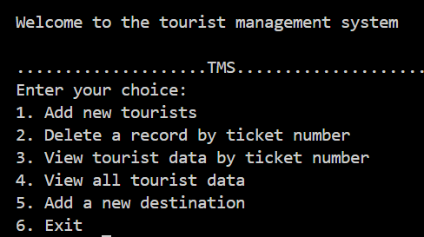
8:Outcomes
Key Outcomes from the Tourist Management System :
I. User-Friendly Interface:
Command-Line Interface: Simple, text-based menu for users to interact with the system, making it accessible and easy to use.
In which Enter your choice portion repeat after 1,2,3,4,5 task are done.
Main menu:

Slide 17
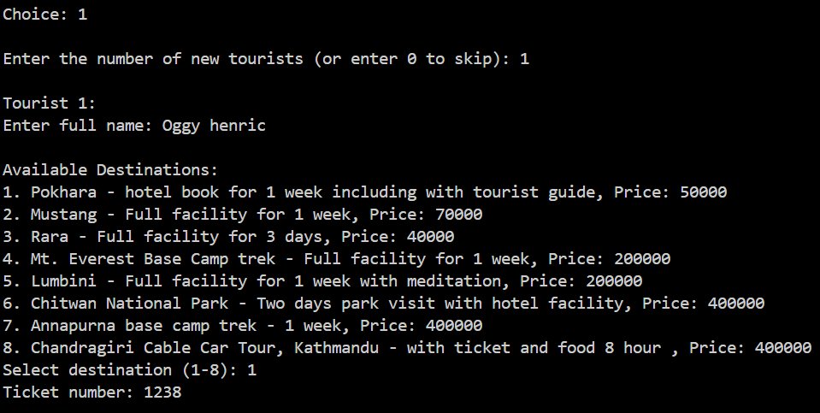
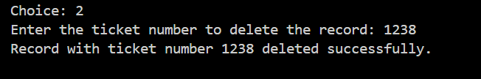
II Efficient Ticket Management:
Add data: Allows Admin to
add tourist data with new tickets with
unique ticket numbers.
2. Deletion/signoff: Facilitates
the deletion of tourist records
by ticket number, maintaining
updated records

Slide 18
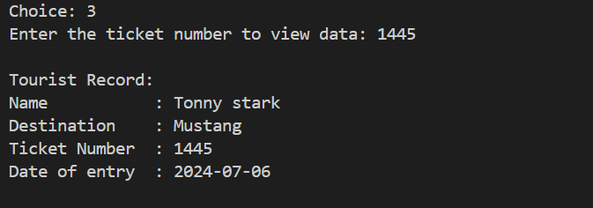
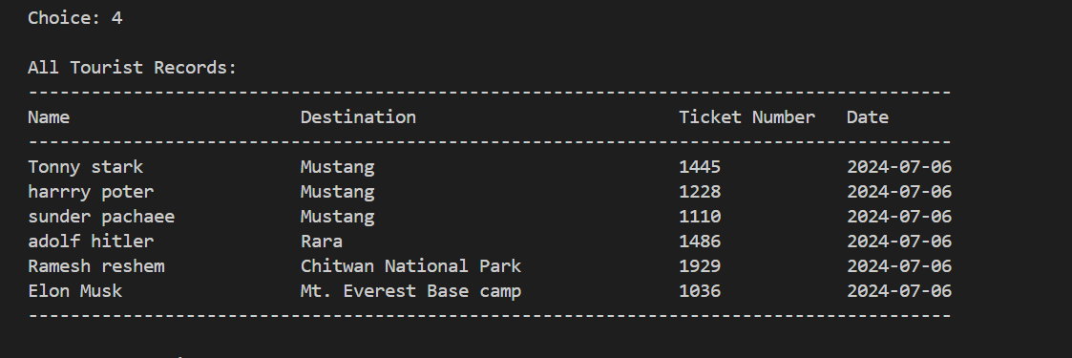
III. Tourist Information Retrieval:
View by Ticket Number: Provides functionality to view specific tourist information by entering the ticket number.
View All Records: Displays all tourist records.

Slide 19
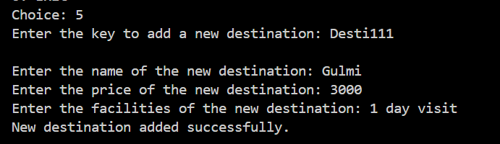
Iv Dynamic Destination Management:
Predefined Destinations: Offers a list of predefined destinations with associated prices and facilities.
Add New Destinations: Admins can add
new destinations securely using a
password-protected feature.

Slide 20
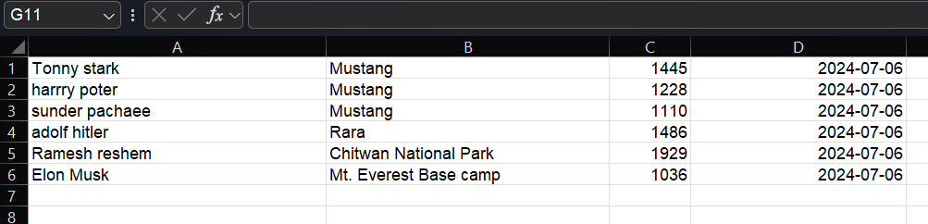

6.Exiting the program.
V. Data Persistence :
File Operations: We can view and copy the data from the excel file .

Slide 21
9:Future Work
The following features are expected to be developed soon which may also depend upon user feedback and responses
Design the system to handle many tourists and data
save the data of tourist after sign off .
Implement a feedback mechanism for users to provided by agent stake holder s and report issues.
Developing a website and a GUI-based application for tourists to manage their travel needs.

Slide 22
Thank You Good bye

Slide 23
dfd
Admin: This is the central entity that interacts with the system. It's responsible for managing and controlling the flow of information related to tourists.
Tourist: This is the external entity representing the tourists. Tourists interact with the system through various requests, such as adding information, viewing details, or deleting data.
Database: This is the central data storage unit. It stores information about tourists, destinations, ticket numbers, and other relevant details.
Add tourist, View tourist, Delete tourist, Add new destination, Generate ticket number and select current date, Exit: These are the processes within the system. Each process performs a specific action on the data, such as adding a new tourist record, viewing existing tourist details, or deleting a tourist record.
Requests and Responses: The arrows between the processes and the Admin represent data flow. Requests are sent from the Admin to the processes, and responses are returned from the processes to the Admin.

